Slide 1

FAKE PRODUCT IDENTIFICATION
TEAM MEMBERS :
Murugaprasad G K 20BCS062
Santhosh S J 20BCS085
Sindhanai Sirpy S 20BCS090
Sri Visnu Ganesh R 20BCS093
Sudharsan R 20BCS097

Slide 2

Problem Statement
There are many fake products in the existing supply chain. It is necessary to have a system for end user to check all details about product that they are buying so that the customer can check if the product is genuine or not.
Counterfeit goods have become a global problem as consumers are being deceived into buying unauthentic goods with no way to validate the authenticity.
In recent years, Counterfeit products play an important role in product manufacturing industries. This affects the company name, sales, and profit of the companies.

Slide 3
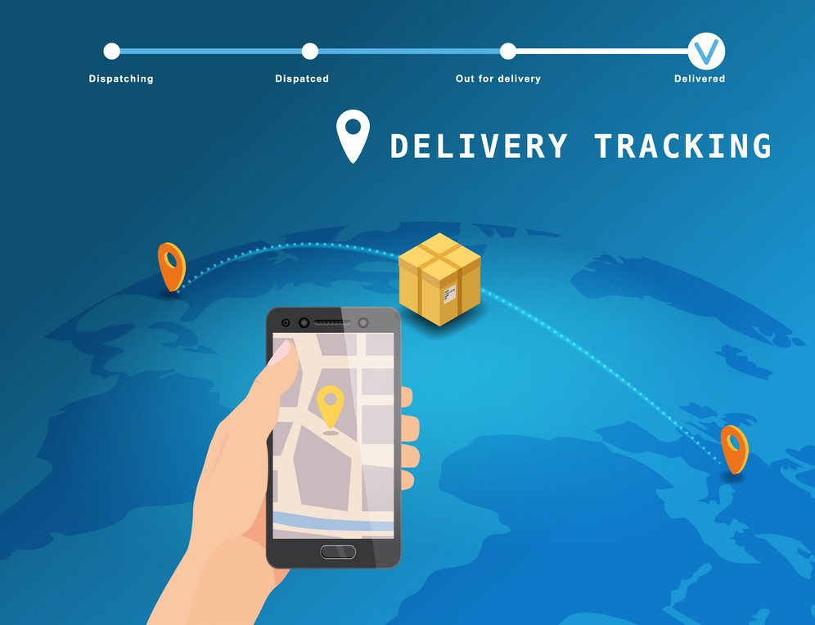
Existing Solution
In the existing system we use product tracking for product delivery.
In this method the admin has all control, so they may modify the data and also we need to go for the third party for making a security.
This system has a lot of possibilities to change the end product to a fake to the customer.

Slide 4
LITERATURE SURVEY

Slide 5
The Power of a Blockchain-based Supply Chain
A supply chain is a system of organizations, people, activities, information and resources involved in moving a product or service from supplier to customer. It is designed to maintain the quality of sensitive goods during the whole shipment.
Centralized supply chain management systems expose the supply chain to corruption, fraud, and tampering. Blockchain has emerged as a new distributed information technology; it represents a new approach in supply chain area, where visibility and transparency of product flows are the principal challenges.
This paper describes how the blockchain can be integrated into the supply chain architecture to create a reliable, transparent, authentic and secure system.
Drawbacks:
Centralized systems are more vulnerable to being hacked.
Centralized systems are more heavily regulated, official licenses are required and certain standards must be kept and complied with by law.
Centralized systems charge you a fee for using the platform.

Slide 6
QR Code Watermarking for Digital Images
With the growing use of online digital media, it is becoming increasingly challenging to protect copyright and intellectual property. Data hiding techniques like digital watermarking can be used to embed data within a signal for purposes such as digital rights management.
This paper investigates a watermarking technique for digital images using QR codes. The advantage of using QR codes for watermarking is that properties of the QR code structure include error correction and high data capacity.
This paper proposes a QR code watermarking technique, and examines its robustness and security against common digital image attacks.
Drawbacks:
Prone to digital image attacks.
The author has not focused on the implementation part, the method of using this watermark algorithm and its problems are not well described.

Slide 7
RFID Anti-Counterfeiting for Retailing Systems
The author proposes an RFID method for detecting counterfeit products and ensuring product authenticity. This RFID system contains two protocols; there are tag authentication protocol and database correction protocol.
The tag authentication protocol to authenticate tags without revealing their important information and its allows the client to query the tag independently.
The RFID tag information use to prevent the spread of counterfeit products. In the mean time, the database correction protocol ensures the correctness of the tag status. Finally, the counterfeit system is very safe against counterfeit and the tag authentication protocol is sufficient to implement it in RFID-based applications.
Drawbacks:
The author has focused the RFID tag technology only applies to expensive products but does not suitable for affordable products.
Anyone can freely request the server to authenticate the tag, the adversary can exploit this characteristic to conduct the Denial-of-Service (DoS) attack.

Slide 8

Holographic Barcodes Using Computer Generated Holograms
The author introduced identification by using methodological barcodes that increase the safety and reliability of the product. User-defined product identification code that is unique and delivered to each is converted to Product Quick Response (QR)code. QR generated code is then converted into a hologram to provide higher security for the product.
The author has focused on holographic barcodes using computer generated holograms are implemented using Matlab. The Barcode decoding gives the reconstructed from the hologram the product identification number assigned to the product.
Finally, the author discussed will help to increase security and authenticity in product identification and to prevent counterfeiting of products.
Drawbacks:
The author has considered only the computer generated barcode using Matlab and has not considered duplicating or photocopy of QR code.

Slide 9
Common Counterfeit Products Deduction Methods
In this study, there are scenarios and research that can help you find fraudulent products. For example, research shows that when a retailer hides its physical address, it scams 50% of the time.
However, there is a gap in research into the ways counterfeiters market their products online and the methods of detecting counterfeit products on real products. Website design may also increase confidence. With increased design, confidence in an online auction house like eBay or a marketplace like Amazon will increase.
Internet auction fraud is one of the fastest growing cyber crimes and presents a challenge to customers during the decision-making process of buying a product.
Drawbacks:
However, to our best knowledge, there are no design artifacts that can help detect counterfeit products. In response to this need, this research aims to develop an automated counterfeit detection by empirically testing its effect on customer buying behavior, following design science research guidelines .

Slide 10

RESEARCH AND ANALYSIS
There has been a lot of research and analysis in the field of fake product detection techniques. To name a few,
Technology based data analytics
Real-time analytics
Predictive analytics
Security analytics
Trust analytics

Slide 11


Our Solution
Recently, blockchain has become more popular as it fosters trust between untrusting participants. This paper uses blockchain technology to combat the sale of counterfeit products.
We use blockchain to allow manufacturers to add authentic product serial numbers onto the ledger; consumers can then use the serial number to verify the authenticity of a product before purchasing it.
Blockchain plays a pivotal role in ensuring that data was not tampered with - creating a trusted environment.

Slide 12
Thank You

